Slide 1

Proline Promass

Slide 2
Measuring principle

Slide 3
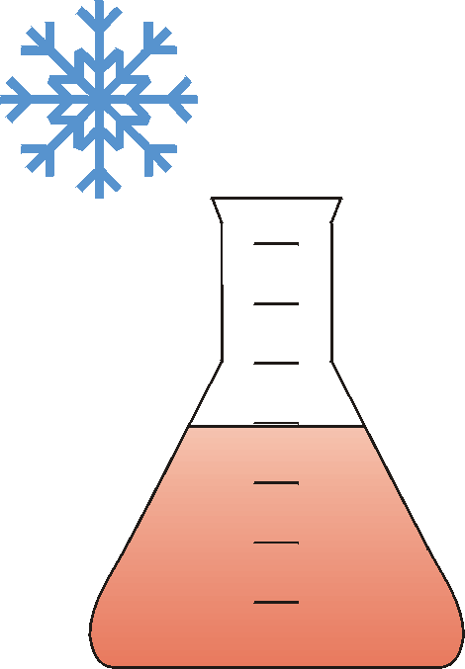
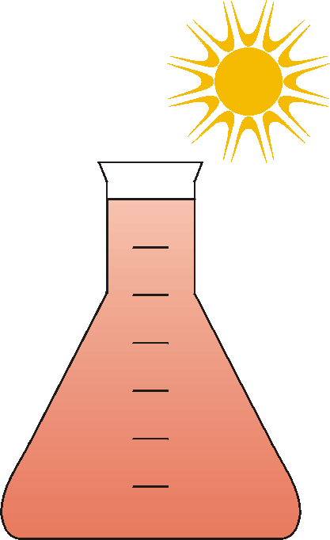
Why Measure Mass?
Principle
Temperature / Pressure
Volume 1 ≠ Volume 2
Mass 1 = Mass 2
Segmentation
Transmitters
Sensors
Advantages
Installation
Masse 1
Volumen 1
Masse 2
Volumen 2
Accessories
Applications

Slide 4
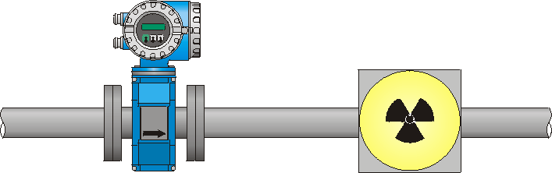
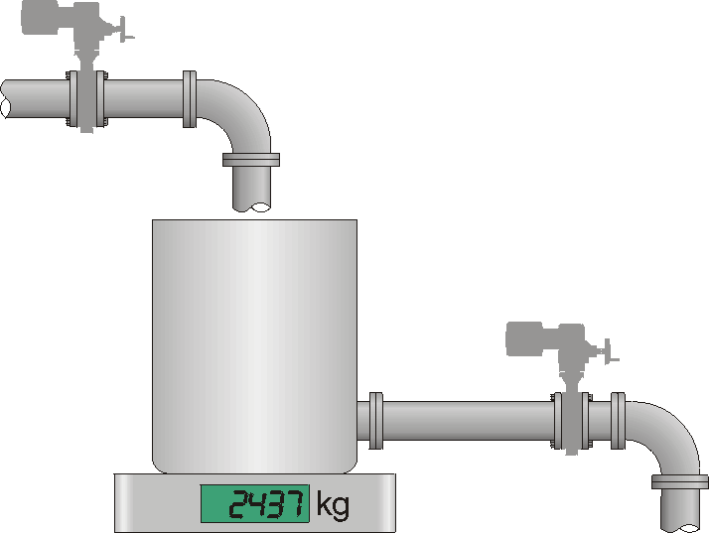
Traditional Mass Flow Measurement
Principle
Discontinuous, direct
Continuous, indirect
Segmentation
Transmitters
Sensors
Advantages
Installation
m_{i}
•
Accessories
V = Volume flow
r = Density
m = Mass flow
Applications
•
m = Σm_{i}
•
•
m = V • ρ

Slide 5
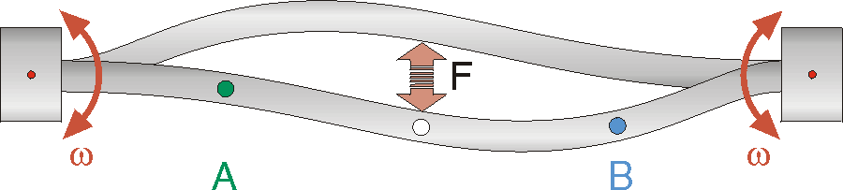
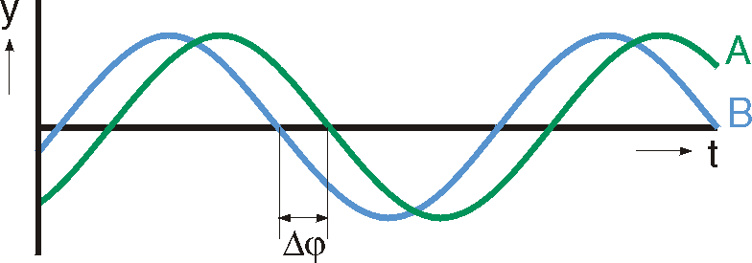
Measurement Signal
Principle
w=Angular velocity
Fc=Coriolis force
Δϕ=time shift
A,B=Sensors
y=Amplitude
t=Time
Segmentation
Transmitters
Sensors
Advantages
Installation
Accessories
Applications
If fluid is flowing, the Coriolis Force introduces a time shift of the swinging points A and B. Point B passes zero before point A . The bigger the flow the bigger the shift.
•
Δϕ ~ F_{c} ~ m
Play Movie

Slide 6
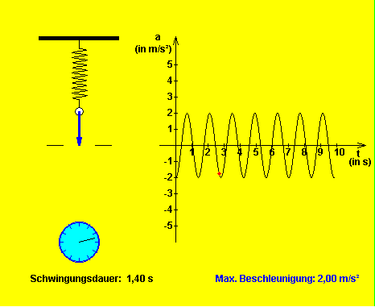
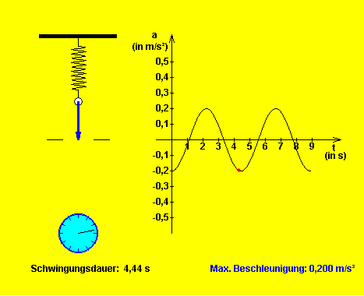
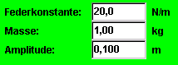
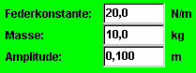
Frequency-shift by Mass-shift
Principle
The resonance frequency of a swinging system is dependent on the stiffness c and the mass m.
The bigger the mass at constant stiffness, the lower the resonance frequency
Segmentation
Transmitters
Spring constant: 20 N/m
Spring constant: 20 N/m
Amplitude: 10 cm
Amplitude: 10 cm
Sensors
Advantages
Mass:
1 kg
Mass:
10 kg
Installation
Accessories
Oscillating time: 1.40 s
Oscillating time: 4.4s
Max. velocity: 0.20 m/s
Max. velocity: 2.00 m/s
Applications

Slide 7
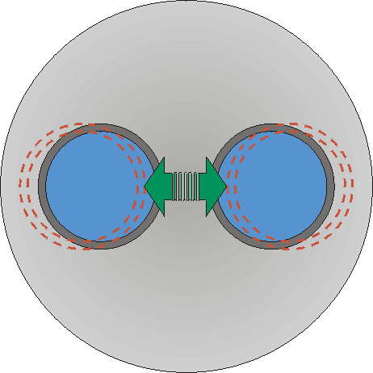
The higher the density the bigger the mass
Principle
m_{t}
f_{R}
Segmentation
Transmitters
f_{R} = Resonant frequency
m_{t} = Tube mass
m_{fl} = Fluid mass
ρ_{fl} = Fluid density
c = Constant
Sensors
Advantages
Installation
m_{fl}
Accessories
DN 25
Density
Applications
Air
950 Hz
1,3
f_{R} = ƒ(ρ_{fl})
Water
740 Hz
1000
The higher the density, the lower the resonance frequency

Slide 8
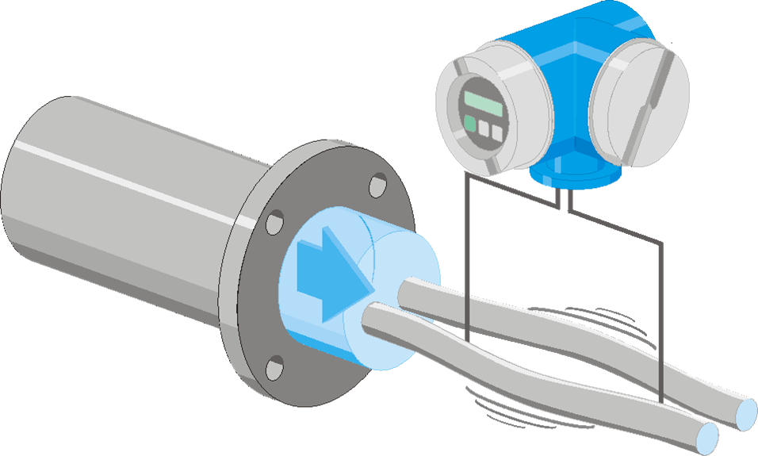
Overview of direct measuring variables
Principle
Dϕ=Phase shift
m=Mass flow
fR=Resonance frequency
r=Density
W= Resistance (PT1000)
T=Temperature
Segmentation
Transmitters
Sensors
Advantages
Installation
Accessories
Applications
Δϕ ~ m
f_{R} ~ ρ
Ω ~ T

Slide 9
Overview of calculated values
Principle
V=Volume flow V=m/r
VN=Normvolume flow = Volume flow at fixed p and T VN= m/rN (note: rN is a fixed value for each fluid)
c=Concentration Concentration can be calculated from density → see specific training (advanced module)
n=Viscosity Viscosity can be calculated from oscillation damping. Viscosity measurement is only available with the Promass I sensor
Segmentation
Transmitters
Sensors
Advantages
Installation
Accessories
Applications

Slide 10


So far, the best coriolis flowmeter on the market
Not affected by :
temperature change
pressure change
external vibration
Tested and calibrated in metrological laboratories complying to ISO 17025
All
our sensors and electronics are produced in Switzerland, with the precision of a Swiss time piece
AS GOOD AS A SWISS WATCH
Notes:
The coriolis flowmeter is one of the state of the art technology and behind the principle there are 30 years experience on the field and improvement over the last decades. We invest a lot of money on the research and development in order to meet the fast moving and demanding expectations. And to prevent from temperature and pressure, vibrations influence, we develop a well balanced system using the best material spiced up with calibration know how. The advantage of such principle operate independantly of temperature, pressure, viscosity, conductivity, flow profil.
When you want to invest on a good quality Cronograph, you will go for Swiss, if you want a silk tie, you will go for french brand, for robust and quality shoes you will go for italian shoes? Won´t you? Therefore if you want a Coriolis flowmeter go for Endress+Hauser.
Is a manufacturer really capable of delivering high precision equipment ? Do instruments maintain their once proven accuracy over time even under changing conditions.
It consists of two variables : 1) the intitial accuracy which is verified by calibration 2) The long term accuracy which is determined by the design.
A watch is only a piece of jewelry. But in a business a wristwatch is considered as a personal statement of taste and status symbol. A perfect watch should be exclusive and yet modest according to my provider like Rolex, Breitling, Omega! And of course precision is absolutely outstanding even under harsh environement. And like our Coriolis, several test are made to test the reliability and the performance
( temperature test, shock test 200 times at 100G) and in the end it has to meet some criteria, for instance in clockwork a maximum permissible daily deviation of +/- 0,07 s that represent 2.10^-4.
What about calibration?
- Comparison of the measurement results of one instrument to the results of the reference instrument. An accredited calibration laboratory has to prove that its reference has a significantly better accuracy than the calibrated meters.
E+H flowtec has been accredited by SAS as a calibration laboratory for flowmeters as per the ISO norms like the independent laboratories for clockwork so called COSC has accredited its services by SAS as per ISO.

Slide 11
Flow accuracy identical for volume and mass
Principle
 | Mass flow Uncertainty (liquid) | Uncertainty of volume flow (liquid)
Promass 83F PremiumCal | 0,05% | ---
Promass 83F | 0,10% | 0,10%
Promass 83S | 0,10% | 0,10%
Promass 83P | 0,10% | 0,10%
Promass 83I | 0,10% | 0,10%
Promass 83A | 0,10% | 0,10%
Promass 83H | 0,10% | 0,10%
Promass 83E | 0,25% | 0,25%
Segmentation
Transmitters
Sensors
Advantages
Installation
Accessories
Applications
Notes:
11
what you have to fathom here is same uncertainty either for volume and massflow according the flow sensors. F sensors is dual tube and most accurate and I sensors is single straight tube.

Slide 12
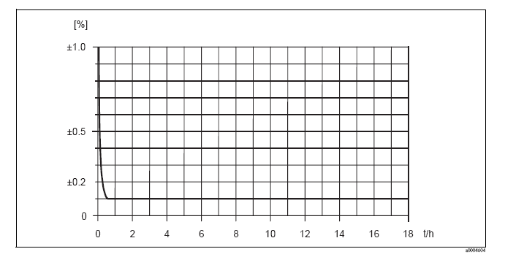
Linear accuracy
Principle
Linear accuracy from 0,5 m/s
New
Segmentation
Transmitters
Sensors
Advantages
Installation
Accessories
Applications
Linear accuracy Highest turndown 25:1
Notes:
12
The accuracy that we specify is valid almost within the whole measuring range from 0,5 m/s
The highest turndown in the market 1:25

Slide 13
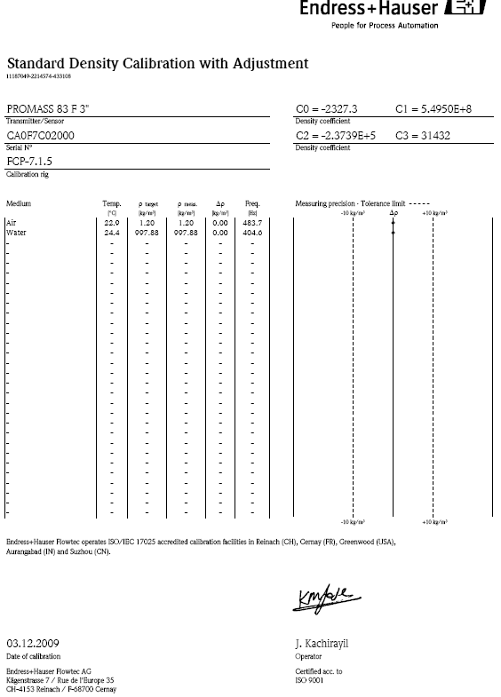
Standard density calibration
Principle
Calibration with air and water under reference conditions.
Standard Certificate
Accuracy : ± 0.5 kg/m3 at ± 50kg/m3 and ±10°C of reference conditions.
Segmentation
Transmitters
Sensors
Advantages
Installation
Accessories
Applications
Notes:
13

Slide 14
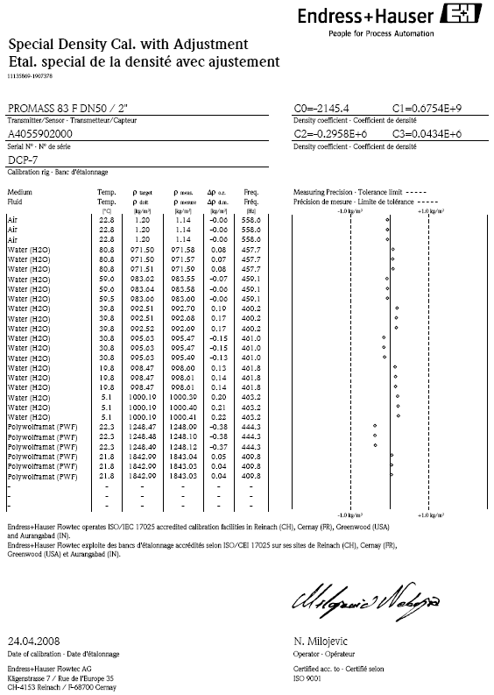
Special density calibration
Principle
Guaranteed accuracy within the whole working conditions of the device
No adjustment required in situ
Linearized device in terms of temperature and density
Segmentation
Transmitters
Sensors
Advantages
Installation
Accessories
Applications
Notes:
14

Slide 15
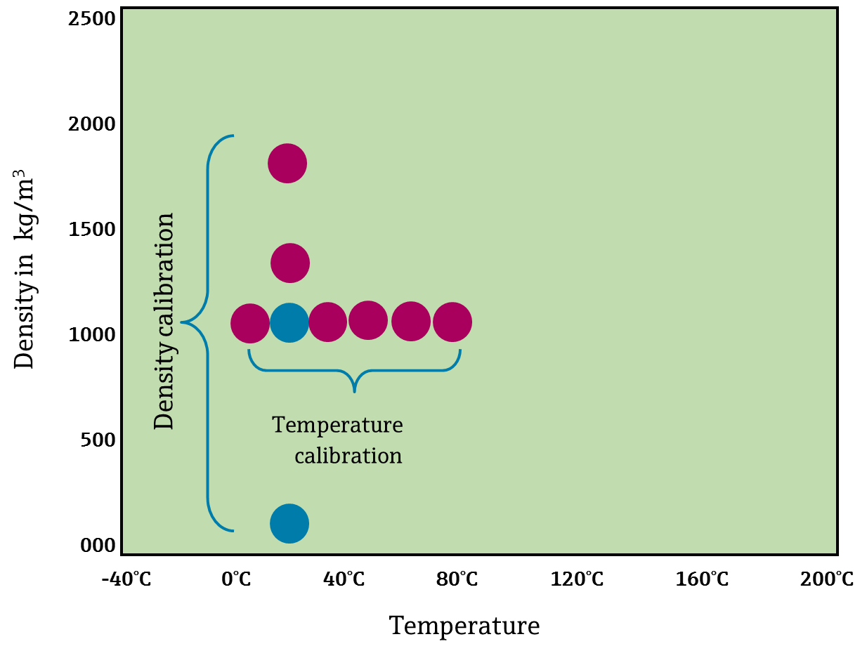
Special density calibration
Principle
Segmentation
Transmitters
Sensors
Advantages
Installation
Accessories
Applications
Notes:
15
If the option special density calibration is selected the Promass will be calibrated with different fluids (=densities) and the temperature characteristics of the device is determined with several measurements at different temperatures with water. This procedure allows to specify a much higher accuracy that is valid within a range of 5…80°C / 1…2000 kg/m³. The densities of the reference fluids range from 820 to 1800 kg/m³.
Most applications are actually within the specified range and a written certificate allows a traceable statement of the performance of an individual meter. This is very unique since no other manufacturer is capable to provide a similar document. That leaves their customers to believe what the supplier promises in his specs. Worse still most suppliers make a statement for reference conditions or for field calibration whilst there is NO accuracy specified for any other (=actual process) conditions.

Slide 16
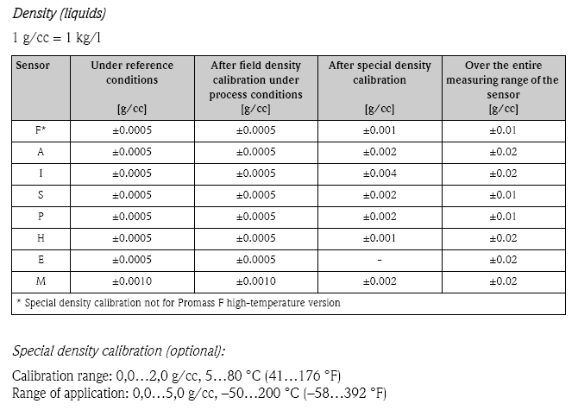
Density specification
Principle
Segmentation
Transmitters
Sensors
Advantages
Installation
Accessories
Applications
Notes:
16
Standard : 2 points Air et eau
Précision : ± 0.5 kg/m3 pour masse volumique à ± 50kg/m3 et ±10°C des conditions de références.

Slide 17
Segmentation

Slide 18
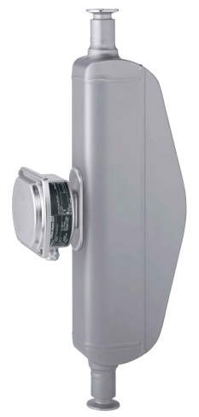
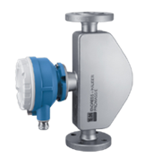
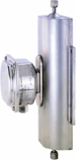
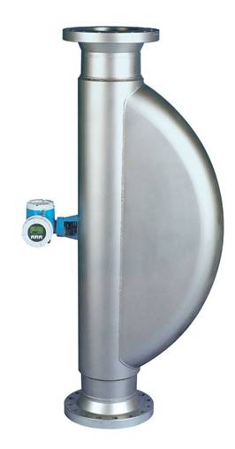
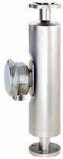
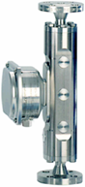

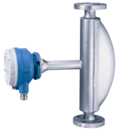
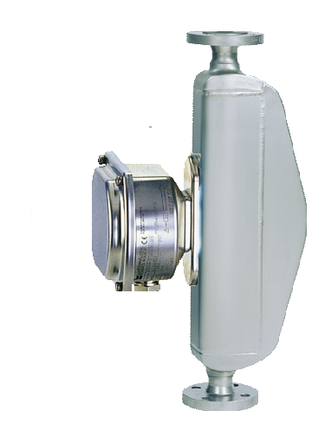
Promass Sensors
Principle
Promass E
Promass A
Promass F HT
Promass S
Segmentation
Promass F
Transmitters
Sensors
Advantages
Installation
Promass I
Promass M
Promass H
Promass P
Accessories
Applications
PHASE OUT
Notes:
18

Slide 19
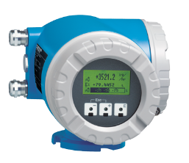
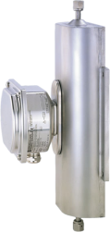
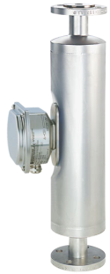
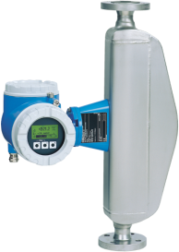
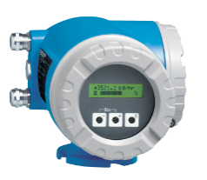
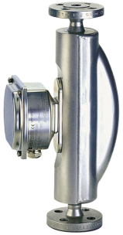
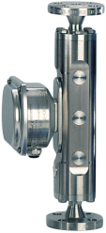

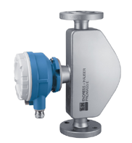
Product Portfolio of Proline Promass
Sensors
Transmitters
A, I, H, S, P
83
80
40
Single Tube Sensors for special applications
Dual Tube Sensors for highest accuracy requirements
M, F,
The Economic Sensor for replacing volumetric flow-meters
E
Basic Standard High End
Performance

Slide 20
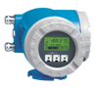
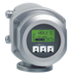
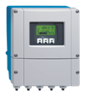
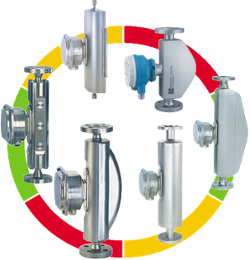
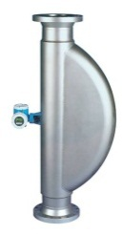
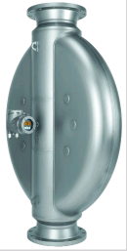
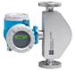
The Coriolis Range
Principle
The most complete range
9 sensor models (DN1…350)
0,08 kg/h to 4100 tons/h
Stainless steel 904L, 316L, Alloy C-22, titanium and zirconium
Working Conditions
-200°C to 350 ° C
Up to 400 bar
Performance uncertainties :
Lin. accuracy > 0,5 m/s
Mass flow up to 0,05 %
Density : ± 0, 5 kg/m³
Accuracy volume = masse
Segmentation
Transmitters
Sensors
Advantages
Installation
Accessories
New
Applications
Notes:
20

Slide 21

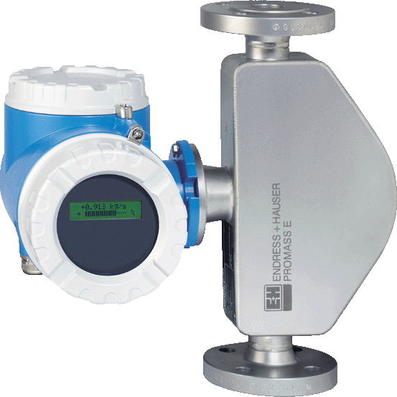
Proline 40: The basic Economical solution
Principle
Communication
0/4..20mA; 0...1kHz
HART
Service interface (Connection to Tooling)
Up to 3 cable glands
Human Machine Interface (HMI)
Blind version
optionally: 2-line back-
lit display in plain text
Measuring values
m, V
Data storage
S-DAT™
Segmentation
Transmitters
Sensors
Advantages
Installation
Accessories
Applications
Digital Com

Slide 22
Transmitters

Slide 23
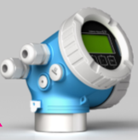
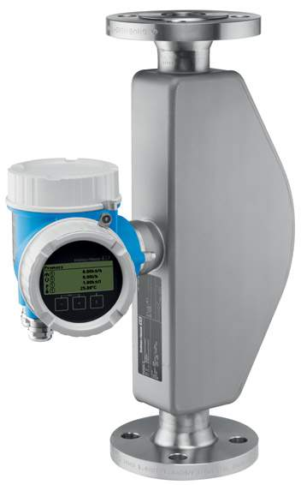


Promass 200 - 2 wire : The basic Economical solution
Principle
Communication
2 wires
0/4..20mA; 0...1kHz
HART
Service interface Connection to Tooling)
Up to 3 cable glands
Human Machine Interface (HMI)
Blind version
optionally: 4-line back-lit LCD display in plain text
Extended diagnostics NE107
Measuring values
m, V
Data storage
S-DAT™, datalogging, liner recorder
Segmentation
Transmitters
Sensors
Advantages
Installation
Accessories
Applications
SIL

Slide 24
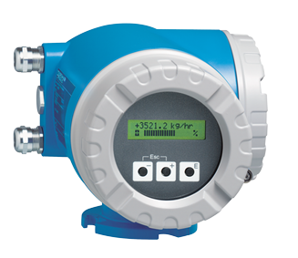

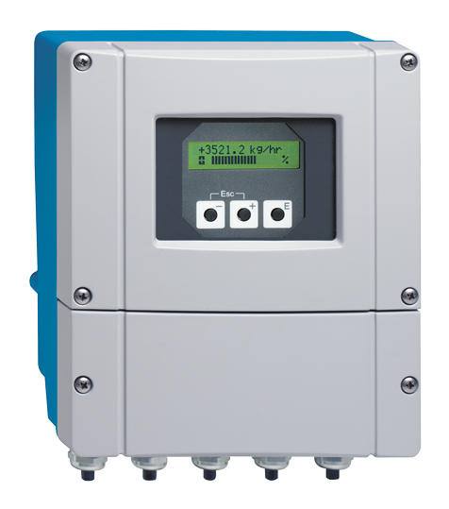
Promass 80: The Standard Transmitter
Principle
Communication
0/4..20mA; 0...1kHz
HART + Profibus PA
Service interface (Connection to Tooling)
Up to 5 cable glands
Human Machine Interface (HMI)
Quick Setup for a fast and easy commissioning
Push-button operation
2-line back-lit display: Display in plain text
Measuring values
m, V, ρ, T
Data storage
S-DAT™
Segmentation
Transmitters
Sensors
Advantages
Installation
Accessories
Applications

Slide 25

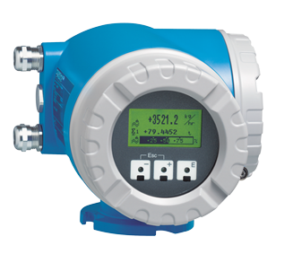

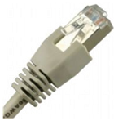
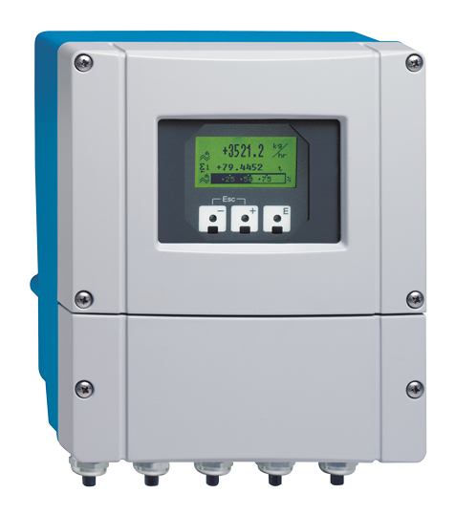
Promass 83: The High-End Transmitter
Principle
Communication
Flexible I/O-Modules
HART, PA, DP, FF, Modbus, Ethernet
Service interface (connection to Tooling)
Human Machine Interface (HMI)
Quick Setup for a fast and easy commissioning
Touch Control operation allows programming without opening of electronics
4-line back-lit display
Modular Software concept
Concentration calculation (Brix, Plato, °API, etc)
Batching functions
Viscosity measurement and
Advanced diagnostics
Data storage
S-DAT™, T-DAT™, F-CHIP™
Segmentation
Transmitters
Sensors
Advantages
Installation
Accessories
Applications
Digital Com

Slide 26
Sensors

Slide 27
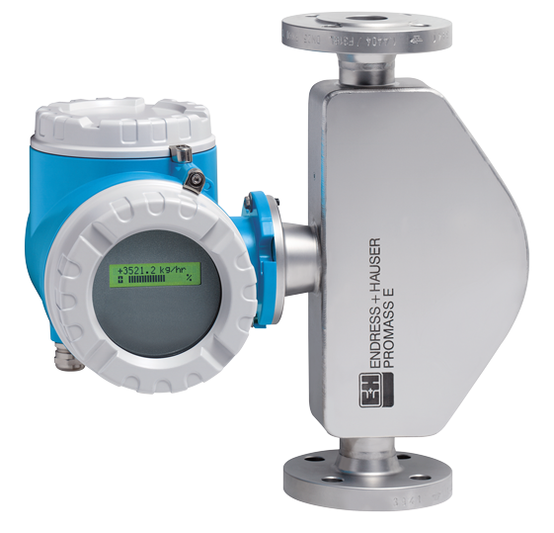
Promass E200: Features
Principle
Flow Measuring Uncertainty:
Liquid Mass ± 0.5%
Liquid volume ± 0.5%
Gas Mass ± 1%
Flow Measuring Repeatability:
Mass/volume Flow (liquid): 0.25%
Mass (gas) : 0,5 %
Flow Range Liquid
DN8 2000 kg/h
DN15 6,500 kg/h
DN25 18,000 kg/h
DN40 45,000 kg/h
DN50 70,000 kg/h
DN 80 180, 000 kg/h
Available with Ex-Certificates:
ATEX
FM/CSA
Segmentation
Transmitters
Sensors
Advantages
Installation
Accessories
Applications
Plan Safety

Slide 28
Promass 82BE: Features
Principle
Flow Measuring Uncertainty:
Liquid Mass ± 0.25%
Liquid volume ± 0.25%
Flow Measuring Repeatability:
Mass/volume Flow (liquid): 0.25%
Mass (gas) : 0,5 %
Density uncertainty:
0,0005 kg/l
Flow Range Liquid
DN8 2000 kg/h
DN15 6,500 kg/h
DN25 18,000 kg/h
DN40 45,000 kg/h
DN50 70,000 kg/h
Certificates:
ATEX
FM/CSA
SIL proven in use
NE107 Namur for diagnostics
Segmentation
Transmitters
Sensors
Advantages
Installation
Accessories
Applications
Plan Safety

Slide 29
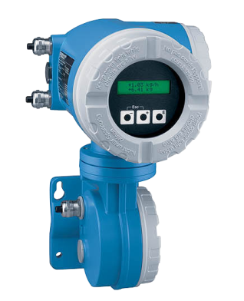


Promass 80/83 E: Features
Principle
Flow Measuring Accuracy
Liquid Mass : ± 0.30/0.25%
Gas Mass : ± 0.75%
Flow Measuring Repeatability:
Mass Flow: 0.01%
Flow Range Liquid
DN8 2000 kg/h
DN15 6,500 kg/h
DN25 18,000 kg/h
DN40 45,000 kg/h
DN50 70,000 kg/h
DN80 180,000 kg/h
Density Measuring Uncertainty:
Field Calibration: ±0.0005 kg/l
Entire range/sensors: ±0.020 kg/l
Temperature Measuring Uncertainty: 0.5° ± 0.005 x T
Segmentation
Transmitters
Sensors
Advantages
Installation
Accessories
Applications

Slide 30

Promass E Sensor Construction
Principle
Segmentation
Transmitters
Sensors
Advantages
Installation
Accessories
Simple and robust design.
Sensor housing may contain pressure up to 15 bar
Applications

Slide 31




Promass 80/83 F: Universal Solution
Principle
Application
Low pressure gases (e.g. natural gas, air)
LPG (e.g. butane, propane)
Fuel oils and gasoline
Fruit concentrates
Vegetable oils, animal fats
Alcohol
Detergents and solvents
Latex, Silicon oil
Toluene, Benzene
Cryogenic gases to -196°C
Segmentation
Transmitters
Sensors
Advantages
Installation
Accessories
Applications
“The standard for almost
every application, our most accurate meter!”

Slide 32




Promass 80/83 F: Features
Principle
Flow Measuring Uncertainty:
Liq. Mass : ± 0.15/0,1% ± 0.05% optional for 83F
Gas Mass : ± 0.35%
Flow Measuring Repeatability:
Mass Flow: 0.05%
Flow Range:
DN8 2000 kg/h
DN15 6,500 kg/h
DN25 18,000 kg/h
DN40 45,000 kg/h
DN50 70,000 kg/h
DN80 180,000 kg/h
DN100 350,000 kg/h
DN150 800,000 kg/h
DN250 2,200,000 kg/h
DN 350 4,100,000 kg/h
Density Measuring Uncertainty:
Field/Ref. Calibration: ±0.0005 kg/l
Special Calibration: ±0.001 kg/l
Standard Calibration: ±0.010 kg/l
Repeatability: 0.00025 kg/l
Segmentation
Transmitters
Sensors
Advantages
Installation
Accessories
Applications

Slide 33

Promass F: Sensor Design
Principle
Electrodynamic sensors
Rigid carrier tube
Measuring tube
Segmentation
Transmitters
Sensors
Advantages
Exciter
Secondary containment rated up to 40 bar
Installation
Accessories
Filled with Nitrogen
Applications
The rigid carrier tube withstands all loads in a piping system, allowing for true “Fit and Forget”.
No extra measures like pipe line support needed.
No restrictions on pipe mismatch.

Slide 34
Also available in high temperature version
Principle
Technical data
Fluids: Liquids and gases
Nominal diameter: DN25 (1”), DN50(2”), DN80(3”)
Temperature: -50...350°C
Tube Material: Alloy C-22
Flow splitter material: SS 316L (optional Alloy C-22)
Flange material: SS 316L (optional Alloy C-22)
Connections: Flanges DIN PN40,
ANSI Cl.150, 300
JIS 10K, 20K
Segmentation
Transmitters
Sensors
Advantages
Installation
Accessories
Applications

Slide 35



Promass 80/83 A: When Every Drop Counts
Principle
Applications
High-pressure gases (up to 400bar)
Low pressure gases (e.g. helium, hydrogen, air)
Additives and flavors
Perfume
DI-water
Insulin
Glue
Segmentation
Transmitters
Sensors
Advantages
Installation
Accessories
Applications
“Sometimes the little things in life
count the most!”

Slide 36


Promass 80/83 A: Features
Principle
Flow Measuring Uncertainty:
Liquid Mass : ± 0.15/0,1%
Gas Mass : ± 0.50%
Flow Measuring Repeatability:
Mass Flow: 0.05%
Flow Range
DN1 20 kg/h
DN2 100kg/h
DN4 450 kg/h
Density Measuring Uncertainty:
Field/Ref. Calibration: ±0.001 kg/l
Special Calibration: ±0.002 kg/l
Standard Calibration: ±0.020 kg/l
Temperature Measuring Uncertainty:
± 0,5°C
Segmentation
Transmitters
Sensors
Advantages
Installation
Accessories
Applications

Slide 37

Promass A: Sensor Design
Principle
Segmentation
Transmitters
Sensors
Advantages
Installation
Accessories
Applications

Slide 38

Promass 80/83 I: Features and Benefits
Principle
Diameter range 3/8"...3” (DN 8 ... 80)
Single straight tube design, Full-bore version
Low pressure drop reduces the cost of ownership.
"Gentle" treatment of measured liquid.
Fully drainable.
Torsion mode balanced system TMB™
No pipe line support needed = Lower installation cost
extended vibration immunity.
Fully welded version
No gaskets: = reduction of maintenance cost
Wetted parts from Titanium
High corrosion resistance
Can be used up to 150°C
Segmentation
Transmitters
Sensors
Advantages
Installation
Accessories
Applications

Slide 39


Promass 80/83 I: The Specialist
Principle
Application
Yogurt with fruit pieces
Syrup/Molasses
Chocolate with nut pieces
Blood plasma (sterile)
Detergents, solvents
Colors
Liquefied gases
Cosmetics
Segmentation
Transmitters
Sensors
Advantages
Installation
Accessories
Applications
Also measures viscosity

Slide 40

Promass I Patented Viscosity control
Diameter DN 8 ... 80
...with flow rates 10kg/h...180’000 kg/h
Wide range of application and industries.
Torsion Mode Balancing TMB™
Low pressure drop
Dual frequency oscillation means the measurement is immune to bubbles etc
No shearing stress
Single straight tube
No fixing accessories required
Perfect for waste oil metering
Lower installation cost and better vibration immunity
Fully welded no gaskets
Reduction of possible leakage points and maintenance cost
Notes:
The torsional movement of the measuring tube can be used to measure the viscosity of the fluid.
Due to the rotational motion v of the tube, the fluid is forced to a rotational motion. Depending on the viscosity, we find different velocity profiles v of the
fluid. Due to the velocity gradient of the profile there are shear forces in the fluid.
These shear forces damp the measuring tube and can be measured via excitation current, which is necessary to maintain the tube oscillation.
By measuring the excitation current (tube damping), the viscosity of the fluid can be determined

Slide 41

Promass I Construction
Exciter et eccentric sensors/ balancing tube. Optimized for a better stability on inhomogeneous fluids and viscosity measurement
Balancing tube
Fixation 2
Measuring tube
Fixation 1
Sensor 1
Exciter
Torsion bar
Sensor 2
Performance : liquid flow 0, 1% of mV + zero stability (density 2 kg/m3)
Gas flow 0,5% of mV + zero stability

Slide 42

Internal view
Principle
Segmentation
Transmitters
Sensors
Advantages
Installation
Accessories
Applications

Slide 43
Optimized balancing system
Principle
DUAL MODE Promass I is the first Coriolis using two simultaneously resonance frequencies. This means measurement of viscosity and mass flow without interference.
Segmentation
Transmitters
Torsion mode (900Hz)
Viscosity
Lateral mode 600-700 Hz
Massflow
Density
Sensors
Advantages
Installation
Accessories
Applications
Notes:
Do Promass I meters still use TMB balancing?
TMB comprises the overall know-how of E+H single tube technology. According to TMB vibration energy is transformed into the torsional motion which can be decoupled from environment. The balancing concept of Promass I redesign can be conceived as a novel implementation of TMB.
Due to different resonance frequencies and the newly introduced dual mode the results for viscosity measurements in non-newtonian fluids may differ.
It is now possible to order the viscosity software package without special density calibration!
Massflow and zero point specifications have been improved significantly.
Stability and performance of mass flow and viscosity measurements at multiphase conditions have been improved significantly
Air bubbles in the process result in an increased exciter current due to the dampening effect. For the initial Promass I this affected also the viscosity measurement and resulted in unstable performance.
eddy current brake has been removed from the internal structure. This improves the performance at inhomogeneous process conditions dramatically.

Slide 44
Accuracy and measuring ranges
Principle
Accuracy with newtonian fluids: ± 5% ± 0.5 mPas (cP)
Repeatability: 0.5%
Segmentation
Transmitters
Sensors
Advantages
Installation
Accessories
Applications

Slide 45


Promass S, the Sanitary meter for the Food Industry
Principle
Mass flow (liquid): ± 0.1% (83) ± 0.15% (80)
Volume flow (liquid): ± 0.25% (83) ± 0.3% (80)
Standard density: ±0.01 g/cc
Special density: ±0.002 g/cc
Field density / calibration or under reference conditions: ±0.0005 g/cc Repeatability = 0.00025g/cc
Temperature: - 50°C to 150°C
Segmentation
Transmitters
Sensors
Advantages
Installation
Accessories
Applications
There is no better single tube coriolis meter with stainless steel tubing!

Slide 46



Measuring tube material
Principle
Promass S
Measuring tube 1.4539 / 904L for outstanding corrosion resistance.
Process connection 1.4435 / 316L
Surface finish 0.8um
EHEDG certified, 3-A approved,
pigable, for cost saving cleaning
Segmentation
Transmitters
Sensors
Advantages
Installation
Accessories
Applications
The meter that meets all the requirements of the food industry

Slide 47









Promass S hygienic process connections
Principle
Segmentation
Transmitters
Sensors
Tri-Clamp
DIN 11851
SMS 1145
DIN 32676
Advantages
Installation
Accessories
Applications
DIN 11864-3 Form A
DIN 11864-2 Form A
DIN 11864-1 Form A
ISO 2852
ISO 2853

Slide 48
Temperature shocking, CIP/SIP simulation
Principle
Segmentation
Transmitters
Sensors
Advantages
Installation
Accessories
To ensure the flow meter can handle thermal shock as experienced in the CIP process.
Temp cycled between 10°C and 140°C
No effect found on meter performance afterwards
Applications

Slide 49
Promass Portfolio: Certification and Hygienic Design
Principle
Certification
Hygienic Design
Segmentation
3-A
EHEDG
Custody Transfer
Piggable
Temp >135 °C
Drainable
Transmitters
Promass A
✓
✓
✓
✓
Sensors
Advantages
Promass E
✓
Installation
Promass S
✓
✓
✓
✓
✓
Accessories
Promass F
✓
✓
✓
✓
Applications
Promass I
✓
✓
✓
✓
✓
Dosimass
✓
✓

Slide 50



Promass 80/83P the Pharma meter
Principle
Promass P
Certification for highly regulated industries: ASME BPE Certificate of Compliance to relevant scope
Inspection certificates: EN 10204 3.1, MTR; - for material, surface roughness, and delta ferrite.
Material selected according to ASME BPE - 1.4435 / 316L, low delta ferrite
Wetted surfaces: Ra max=0.76 µm or Ra max=0.38 µm
Electropolished flow tube and process connection and electropolished exterior: for sterile, easier cleanability and higher corrosion resistant surface
Hygienic fully welded, sensor design for full drain ability
“Designed for CIP/SIP” Continuous measurement with fast recovery - no delay
Accredited flow calibration
according to ISO/IEC 17025 (SCS/A2LA),
traceable density calibration
Segmentation
Transmitters
Sensors
Advantages
Installation
Accessories
Comes with all the paper work so you can focus on the “not so compliant” parts of your plant
Applications

Slide 51

Measuring tube material
Principle
Promass P
Measuring tube 1.4435 / 316L (low delta ferrite)
Process connection 1.4435 / 316L (low delta ferrite)
Surface finish Ra max = 0.76µm (mechanical polish)
Surface finish Ra max = 0.38µm (electropolished)
EHEDG certified, 3-A approved
Segmentation
Transmitters
Sensors
Advantages
Installation
Accessories
Applications

Slide 52


Promass P Measuring Accuracy
Principle
Mass flow (liquid): ± 0.1% (83) ± 0.15% (80)
Mass flow (gas): ±0.50%
Volume flow (liquid): ± 0.25% (83) ± 0.3% (80)
Standard density: ±0.01 g/cc
Special density: ±0.002 g/cc
Field density / calibration or under reference conditions: ±0.0005 g/cc
Temperature: - 50°C to 200°C
Segmentation
Transmitters
Sensors
Advantages
Installation
Accessories
Applications

Slide 53

Promass 80/83 H: Features
Principle
Flow Measuring Uncertainty:
Liquid Mass/Vol: ± 0,1/0.15% ± zero point
Gas Mass : ± 0.50% ± zero point
Flow Measuring Repeatability:
Mass Flow: 0.05% ± 1/2 zero point
Flow Range
DN8 2000 kg/h
DN15 6,500 kg/h
DN25 18,000 kg/h
DN40 45,000 kg/h
DN50 70000 Kg/h
Density Measuring Uncertainty:
Field/Ref. Calibration: ±0.0005 kg/l
Special Calibration: ±0.002 kg/l
Standard Calibration: ±0.020 kg/l
Temperature Measuring Uncertainty:
± 0,5°C
Segmentation
Transmitters
Sensors
Advantages
Installation
Accessories
Applications

Slide 54
Promass H: Cross Sectional View
Electrodynamic sensors
Secondary containment
Principle
Balancing Weight
Segmentation
Exciter
Transmitters
Sensors
Advantages
Measuring tube
Installation
Balancing Tube
Accessories
Measuring and Balancing tube couplers
Applications
Balancing Tube Weights
The Endress+Hauser patented ITB – System (Intrinsic Tube Balancing):
An attached balancing tube and Balancing weights ensure perfect balancing allowing for true “fit and forget”
Slide 54
Endress+Hauser Consult AG Sales Support

Slide 55

Application for tantalum
Principle
Tantalum has the widest spectrum in corrosive environment
Zirconium become an alternative in reducing area
Corrosion test by CIBA (chemical company)
Tube + flanges face + welding
HCL 32% @ 95°C
H₂SO₄ 96% @120°C
Important reminder:
Chemical compatibility has to be validated by the customer !
Samples are available on requirement
Segmentation
Transmitters
Sensors
Advantages
Installation
Accessories
Applications
Notes:
For the time being, we do never specify a life time for a sensor in specific media or apllications. Since the life time in aggressive media can be heavily influenced by changes in temperature, concentration or contaminants!
55
18.10.17

Slide 56
Some examples of applications for tantalum
Principle
Typical applications – Masse Flow / Volume flow, density and concentration measurement :
32% HCL (hydrochloric acid) @ 150 °C
96% H₂SO₄ (Sulfuric acid) @ 120 °C
65% nitric acid @ 100 °C
85% phosphoric acid @ 100 °C
Concentration measurement of acids:
Sulfuric acid @ 1840 kg/m³: ±1% of concentration ⬄ ±8 kg/m³ in density
Hydrochloric acid @ 1500 kg/m³: ±1% of concentration ⬄ ±5 kg/m³ in density
Segmentation
Transmitters
Sensors
Advantages
Installation
Accessories
Applications
Notes:
56
18.10.17

Slide 57
Advantages of Promass

Slide 58



Features / Promass Endress+Hauser
Principle
Compact
Most compact design, lightweight
Secondary containment (excepted sensors E)
Robust construction, improved process security
Immune to vibrations
No affected by pipe vibrations
Self drainable
No dead volume, available as hygienic version
Performance
0.05% with linear precision (>0.5 m/s)
The least affected by temperature or pressure
Segmentation
Transmitters
Sensors
Advantages
Installation
Accessories
Applications
Notes:
58

Slide 59


Compact Construction
Principle
Comparison of sensors 3" (DN 80) Promass
Lightweight
Required little place
No need for support or brackets
Simple Installation
Segmentation
Transmitters
Sensors
Advantages
Installation
Accessories
Applications
Notes:
59
Customers require ease of installation in all three dimensions, not only short face to face length. Important are also ease of access in order to wire the meter.
Lighter weight means also the possibility to install without mechanical support of the pipeline.
Quality requirements in some cases may mean to remove the meter for verification or recalibration, meaning ease of handling is important.
Example comparison in the picture:
Promass M DN80 / 3”
Length = 840 mm
Height = 385 mm
Weight = 67 kg
Emerson MicroMotion
CMF300
Length = 856 mm
Height = 1071.5 mm
Weight = 77 kg

Slide 60

Standard Secondary containment (excepted sensor E)
Principle
Serve as security if the fluid is extremely corrosiv or abrasiv
Specifications are checked by burst test for each diameter (Test certificate delivered by a third part)
Enable to optimized sensors stability for high accuracy insitu
Segmentation
Transmitters
Sensors
Advantages
Measuring tube
Installation
Accessories
Applications
Nitrogen
Secondary containment
Notes:
60

Slide 61



Promass: No sensitive to pipe vibrations
Barreau vibrant
Balanced measuring system
High working frequency ( typically 600 to 1000 Hz) → no interference with oscillations from pipe vibrations (normally around 50 à 250 Hz)
Vibration effect from competition sensors
Vibration effect from Endress+Hauser promass
No twisting occurs on critical points
= Perfect protection
Notes:
61
All Coriolis mass flowmeters are based upon the same principle. The measurement of the mass flow can be achieved with only one measurement tube. But by using only one measurement tube (and no intelligent compensation system), the system is more sensitive against vibration. That is why most manufacturer are offering mass flowmeter with 2 measurement tubes. The 2 tubes are vibrating in opposite direction, making the system an intrinsically balanced one.
This means that no vibration from the vibrating tubes will go outside. Also vibration from the outside is less likely to affect the vibration of the measurement tubes, unless the outside vibration has the same frequency as the meter.
For Promass, the oscillation frequency of the measurement tubes is very high, between 200 and 1000 Hz, typically around 400 to 600 Hz. Meters from the competition usually oscillate between 50 and 200 Hz. In this frequency region, there usually are pipeline vibrations caused by pumps or compressors. If this pipeline vibration is around the same frequency as the Coriolis meter oscillation frequency, the meter can be affected. For this reason competition meter usually are more sensitive to vibration.

Slide 62



Self drainable construction
Principle
For all sensors
No dead volume
No settlings problem
No corrosion
No sensitive to coatings
Certified EHEDG, 3-A
Segmentation
Transmitters
Sensors
Advantages
Installation
Self drainable
With air and liquid
Accessories
Applications
Notes:
62
Each of the Promass sensors is fully drainable if installed in a vertical position. Designs with loops or other designs as found in the portfolio of some competitors don’t offer this advantage.
Depending on the design of the Promass model part drainage of the sensor is often possible sometimes only with a minimal slope. In particular the P sensor is offered with eccentric Clamps that allows to FULLY drain the device even in a horizontal mounting position. This is a requirement often found in the pharmaceutical industry. Promass P is the only Coriolis flowmeter offering this advantage.

Slide 63



Performance - Coriolis E+H
Principle
Accuracy : 0.30% à 0.05%
Linear precision for v > 0.5 m/s
Temperature effect 0.0002%°C
Negligeable pressure effect
Special density calibration possible
The most accurate calibration rig in the world 0.015%, traceable according to ISO17025
Segmentation
Transmitters
Sensors
Advantages
Installation
Accessories
Applications
Notes:
63

Slide 64
Coriolis Endress+Hauser
Principle
High accuracy, zero stability, little sensitive to process variations (P, T°)
Lightweight sensors, compact and robust
Drainable sensors from top to bottom
No sensitive to vibrations
No influence linked to viscosity variations
No inlet or outlet runs required
No filters required
Segmentation
Transmitters
Sensors
Advantages
Installation
Accessories
Applications
Notes:
64

Slide 65


Coriolis flowmeters
Installation guidelines

Slide 66
Coriolis installation considerations: no straight inlet run
Principle
Coriolis meters are not affected by flow profile.
Advantages for installation:
Coriolis flowmeters do not require straight inlet or outlet runs.
Elbows, valves, or pumps upstream do not affect the performance of the meter.
Segmentation
Transmitters
Sensors
Advantages
Installation
Accessories
Applications
Notes:
Most other modern flow principles are based on measuring the fluid velocity and calculate flow from this measurement. In contrast, Coriolis measurement is a direct measurement of mass flow. As a consequence, Coriolis meters do not require straight inlet or outlet runs which are necessary for most other measurement principles. This can be a big advantage when pipeline length is restricted or for the construction of a skid.
For comparison an example of straight run requirements for other measurement technologies after a 90º elbow:
Magmeters: 5xDN straight inlet, 2xDN straight outlet
Ultrasonics (92F): 5xDN straight inlet, 5xDN straight outlet
Vortex meters: 20xDN straight inlet, 5xDN straight outlet
Thermal meters: 15xDN straight inlet, 5xDN straight outlet

Slide 67


Coriolis installation considerations: full pipe (1)
Principle
The measuring tube(s) of a Coriolis meter must be kept full.
Promass triggers “Empty pipe detection” (EPD) warning if density falls below defined limit.
Consider the following recommendations:
Best mounting location: In vertical pipeline with flow streaming upwards
Good alternative: Horizontal orientation on a low point in the pipeline.
Segmentation
Transmitters
Sensors
Advantages
Installation
Accessories
Applications
Notes:
The best mounting location for a Coriolis meter is in a vertical pipeline with the flow streaming upwards. With this orientation, the pipe is either full or completely empty and the empty pipe detection will respond fast and correctly.
If mounting on a vertical pipeline is not possible, a good alternative is installation in a horizontal pipeline on a low point in the pipeline system.
The empty pipe detection (EPD) is a Promass software function which triggers a warning if either the density falls outside limit values which can be chosen according to the application. Factory setting for the low limit values is 0,2 kg/l. If in a liquid application the pipeline is emptied, the density will drop below that limit value and the EPD function will trigger a warning which can be displayed and/or signalled via the status output.

Slide 68


Coriolis installation considerations: full pipe (2)
Principle
Consider the following restrictions:
Avoid installation at the highest point of a pipeline.
Avoid installation directly upstream of a free pipe outlet in a vertical pipeline.
If installation before a free pipe outlet is inevitable:
Decrease nominal outlet diameter (Pipe restrictor or an orifice plate).
Consult operating manual for recommended orifice sizes.
Segmentation
Transmitters
Sensors
Advantages
Installation
Accessories
Applications
Notes:
Mounting at the highest point in the pipeline has to be avoided in any case because in this position the pipeline can easily be partially filled, thus impairing the measuring accuracy of the Coriolis meter.
Installation in a vertical pipeline with downwards flow has to be avoided as well. In this case, the back pressure of the Coriolis meter is equal the (ambient) outlet pressure which can result in the sensor running empty during measurement.
However, there can be situations when this is the only possible installation point for the meter (e.g. in the Chemical or Life Sciences industry when educts are batched into the reactor). In these cases it is recommendable to use pipe restrictors or orifice plates with smaller cross section downstream of the meter. This measure increases the back pressure of the meter which ensures a full measuring tube and thus accurate measurement.
The Promass operating manual lists the recommended inner diameter of a pipe restriction or orifice plate, depending on the nominal diameter of the meter in question.

Slide 69

Coriolis installation considerations: entrained solid
Principle
With curved measuring tubes and horizontal installation:
Entrained solids in liquids: do not install with curves pointing downwards (risk of solids accumulating).
Steam measurement: do not install with curves pointing downwards (risk of condensate accumulating).
Segmentation
Transmitters
Sensors
Advantages
Installation
Accessories
Applications
Notes:
The two cases below have a similar symptom and the same solution yet the root cause is different.
Solids
If solids are present in a liquid there is a risk that the solids settle at the bottom of the tube if the flow is stopped. Worst case the solids “bake” to the tube wall and build up over time. Any build up on the tube wall can cause an unbalance that can lead to an unstable measuring signal and measuring errors.
Condensate in gas/steam
Generally liquids in a gas measurement are not acceptable since two phase fluids are difficult or even impossible to measure accurately. But even in applications where this is not a general problem it might be that any present condensate would collect in the Promass if it is installed in a horizontal pipe. If this occurs the same influence as above will result.
The problems can be minimized or avoided if the sensor is installed under an angle or/and a model is selected that is fully drainable (Promass I or Promass P with eccentric Clamps)

Slide 70

Air entrainment
Principle
All (Coriolis) flowmeters are affected by entrained air.
Promass in combination with FieldCare can be used to detect unknown gas entrainment problems in application (by tracking the stability of the meter’s excitation current).
Effects on measurement depend on the air distribution in the fluid.
Segmentation
Transmitters
Sensors
Advantages
Installation
Bubbles
Accessories
Slug flow
Applications
Partial filling
Or any kind of combination
Notes:
All flowmeters, including all Coriolis meters, are affected by entrained gas. Promass meters do not stall measurement with entrained air; however measurement accuracy will be impaired. The effect on meter performance depends on air amount and air distribution in the liquid.
If there is entrained air in the liquid, the damping of the measuring tube will increase. In consequence the excitation current needed to drive the oscillation of the measuring tube will be higher than in homogeneous flow conditions. This effect can be used diagnose entrained air. In the Promass software, a warning on display and/or output can be generated when the excitation current exceeds a definable maximum value. In combination with the FieldCare operation software, the stability of the meter’s excitation current can be tracked over a longer time period which allows more accurate and more convenient detection of air entrainment.

Slide 71
Possible air entrainment effects on measurement
Principle
Bubbles
Noisy erratic reading depending
on bubble size and quantity
Segmentation
Transmitters
Delayed response mechanism,
erratic reading depending on slug size and frequency. Periodic noise depending on slug and pipe size.
Slug flow
Sensors
Advantages
Installation
Partial filling
Extremely noisy reading, huge errors depending on amount of air, instrument should switch to error mode. Product splashes through the pipes.
Accessories
Applications
Any combination?

Slide 72

Coriolis installation considerations: entrained air
Principle
Do not install with curves pointing upwards (risk of gas accumulating).
If entrained gas (e.g. viscous fluids) is present, increase back pressure (to about 6-10 bar) to dissolve the gas in the liquid and improve performance.
Install on the high-pressure side of a pump and as close as possible to the pump.
Segmentation
Transmitters
Sensors
Advantages
Installation
Accessories
Applications
Notes:
In an application with unwished air entrainment, real improvement can only be achieved by removing the air. The most promising measure is always to increase the application pressure (6-10 bar). Installation on the high-pressure side on the pump and as close as possible to the pump can help to achieve this goal.

Slide 73
Coriolis installation considerations: zero point stability
Principle
Zero point stability is defined by design and manufacturing tolerances of the flowmeter.
Promass normally does not need to be zeroed because of its exceptional zero point stability. (Still it is often common practice to perform a zero point adjustment.)
Occasional zero point adjustment can be considered under the following application conditions (if the flow rate displayed is stable but has an incorrect value):
High viscosity or inhomogeneous fluid
Possibility of abrasion or corrosion of the flowmeter
Mechanical stress on the flowmeter
Segmentation
Transmitters
Sensors
Advantages
Installation
Accessories
Applications
Notes:
NOTE:
Process induced zero point fluctuations might not be stable and constantly the same. Therefore any zero point adjustment is only a temporary remedy removing influences that are present at the moment.

Slide 74

Installation hints
Principle
Promass F
Segmentation
With gas content
Transmitters
Sensors
Advantages
Installation
Promass F
Accessories
With solids content
Avoid installation on suction side of pumps => outgasing of liquids
Applications

Slide 75

Installation hints
Principle
Only use one fixed support
Segmentation
Transmitters
Sensors
Advantages
Installation
Accessories
To avoid cavitation extend reduced length
Applications

Slide 76
Installation hints- liquids with gas content
Principle
Flow devider:
Heavy particles collect on the outer curve, lighter one on the inner one.
Segmentation
Transmitters
Sensors
Advantages
Installation
Accessories
Solutions:
Turbulences to get a homogeneous mixture
Flow conditioner
Increase the system pressure = use valve or orifice after meter
Gas separator before the meter
Applications
90° Bend
Commissioning

Slide 77

Heating Jackets available, order structur DK8HJ-XXXXX
Principle
Laser “Button” weld
Flow diversion weld
Keeps your process warm
Segmentation
Transmitters
Sensors
Promass F Sensor
Advantages
Installation
Accessories
Heating fluid process connection
Available for:
Promass A
Promass E
Promass F
Promass I
Promass M
Applications
Heating Jacket mounting bolts

